Slide 1
Artificial Neural Network
CRC- ANN Coding Class 1
Presenters: Happy & Grace

Slide 2
01
Artificial Neural Network (ANN)?
CONTENTS
02
Architecture of Artificial Neural network
03
Terminologies in Artificial Neural Network
04
Implementation of Artificial Neural network

Slide 3
01
Artificial Neural Network

Slide 4
01
Artificial Neural Network
What is Artificial Neural Network?
Artificial neural network" refers to a biologically inspired sub-field of artificial intelligence modeled after the brain.
An Artificial neural network is usually a computational network based on biological neural networks that construct the structure of the human brain

Slide 5
The Architecture of an ANN
02

Slide 6
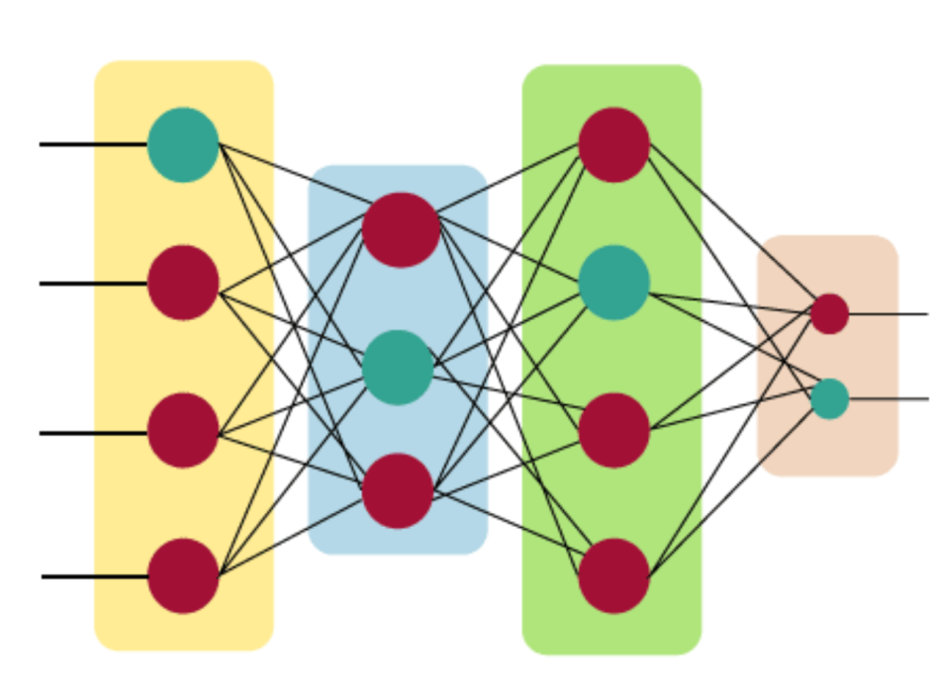
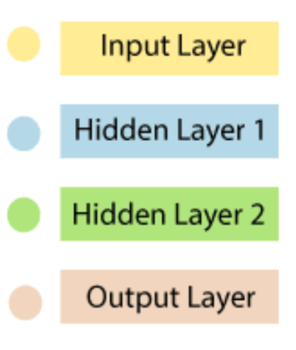
The Architecture of Neural Network
06
The Architecture of an ANN
Artificial Neural Network primarily consists of three layers:
The artificial neural network takes input and computes the weighted sum of the inputs and includes a bias. This computation is represented in the form of a transfer function.

Slide 7
The Architecture of Neural Network
06
Input Layer:
As the name suggests, it accepts inputs in several different formats provided by the programmer.
Output Layer:
The input goes through a series of transformations using the hidden layer, which finally results in output that is conveyed using this layer.
Output Layer:
The input goes through a series of transformations using the hidden layer, which finally results in output that is conveyed using this layer.

Slide 8
03
Terminologies in ANN

Slide 9
Terminologies in Artificial Neural Network
06
Parameters:
weights
Bias
Hyper-parameters:
Learning rate
Optimizer
Number of layers
Activation function
Loss function
Number of neurons

Slide 10
Implementation of ANN
04

Slide 11
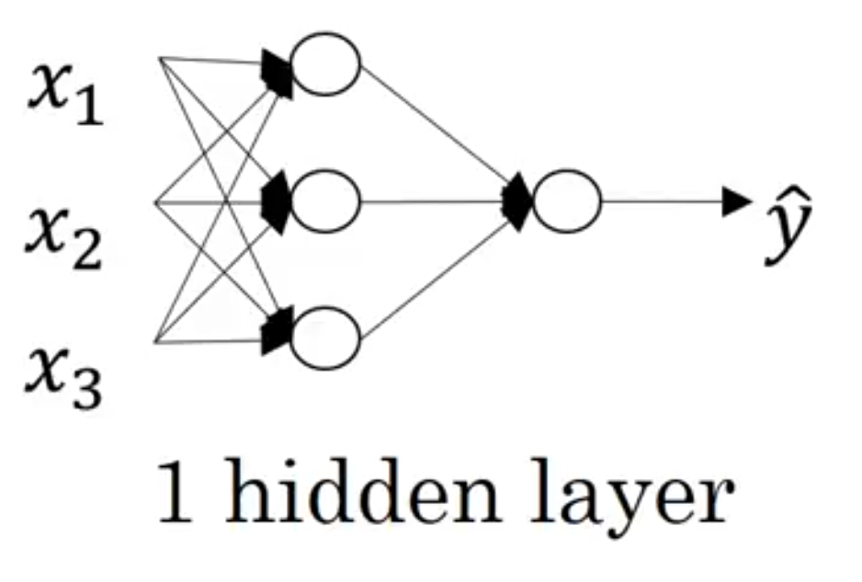
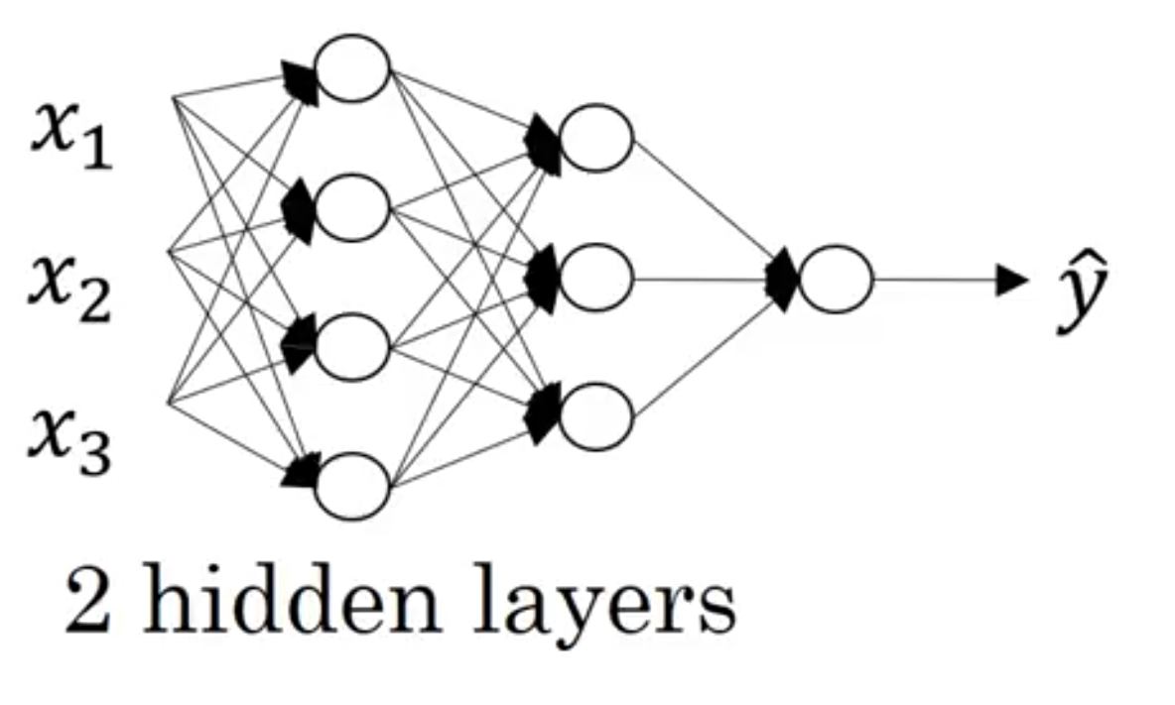
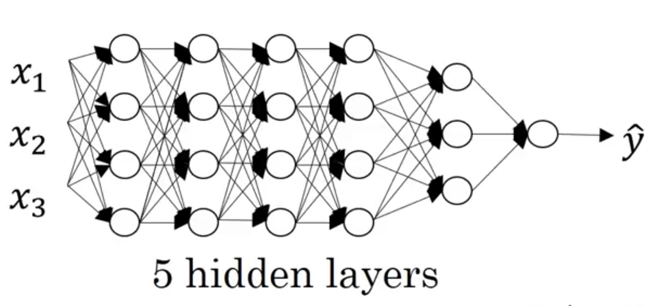
Implementation of ANN
06

Slide 12
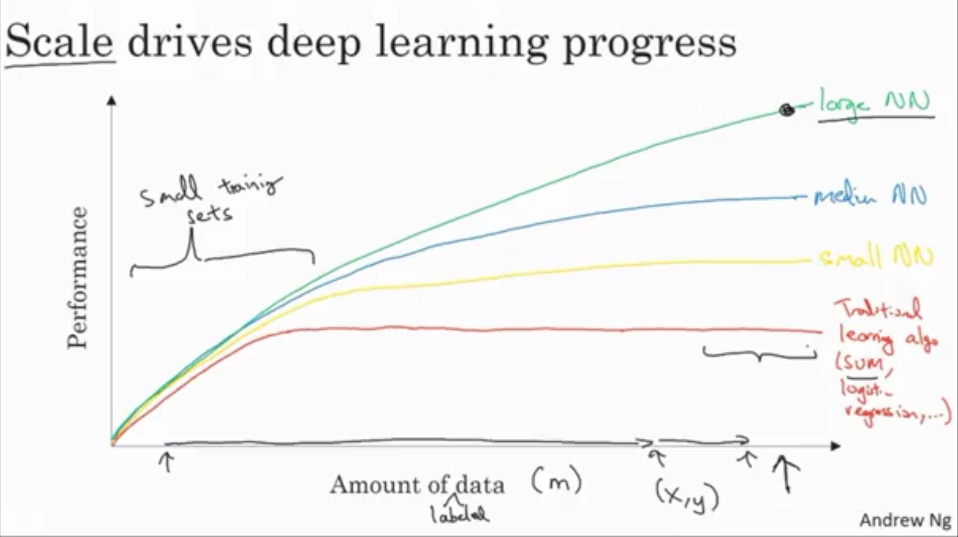
Scale Drives Deep Learning Progress
06
Data
Computation
Algorithms

Slide 13
Thanks for Listening

